Slide 1
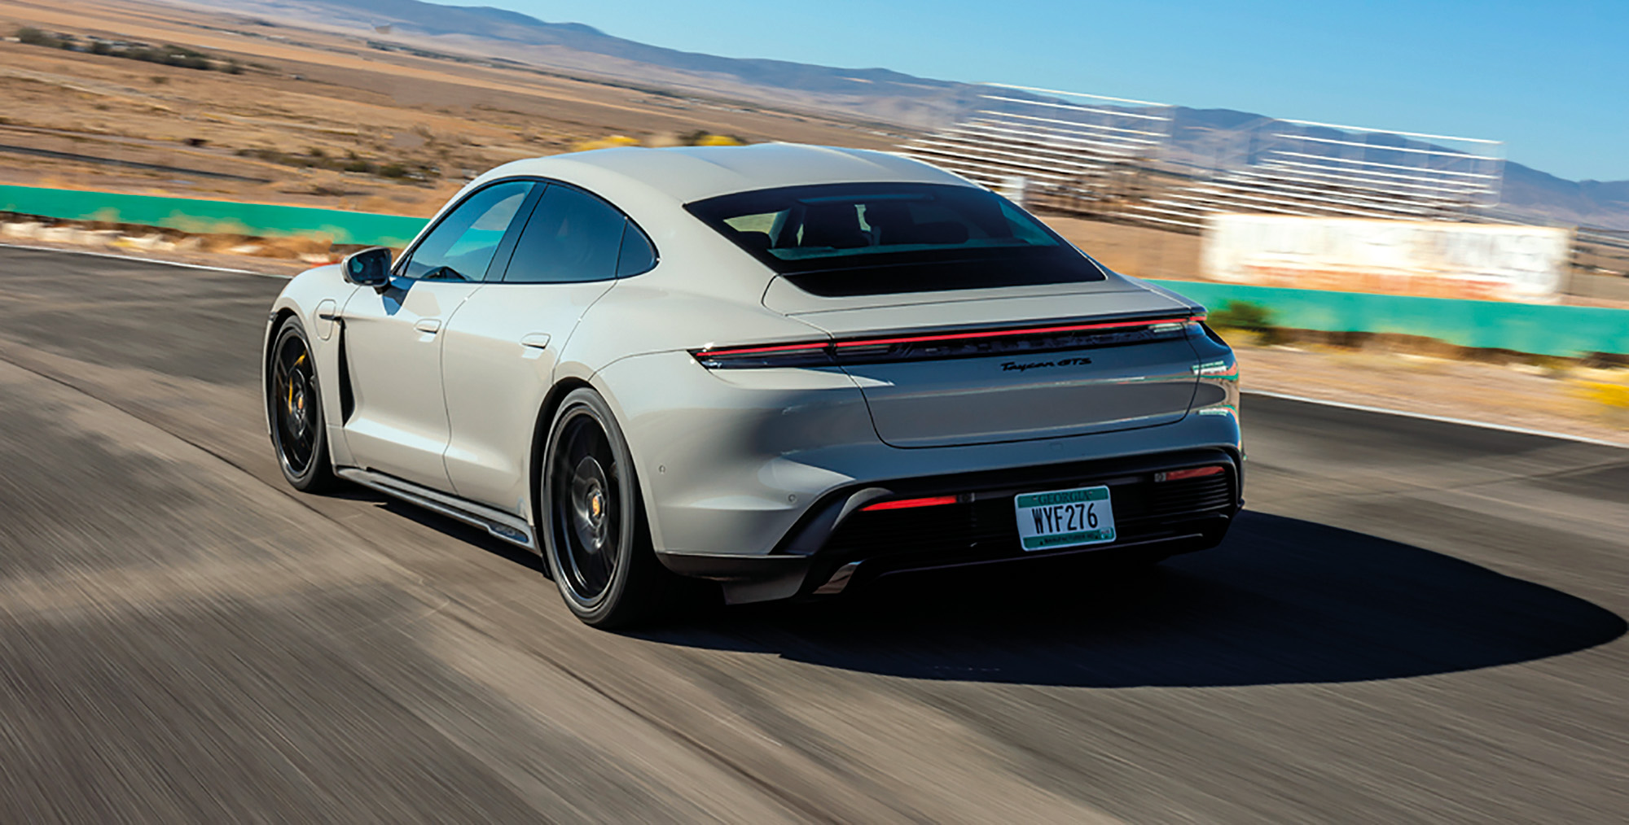
Car price prediction
: Linear Algebra for Data Science

Slide 2
Data
An automobile company wants to predict the car price that the customers are willing to pay for a new car.
Given a few customer features such as age, annual salary and net worth, we can build a linear regression model to predict the expected car price.
Data Source: https://www.kaggle.com/datasets/dev0914sharma/car-purchasing-model

Slide 3
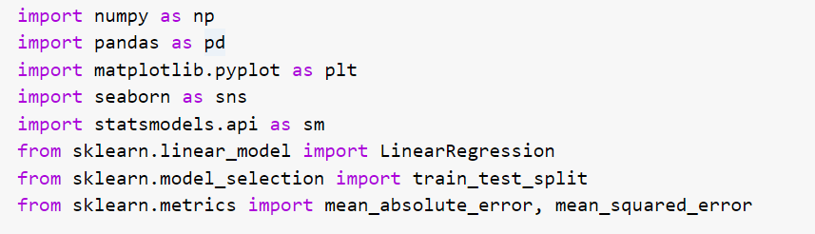
Import Library

Slide 4
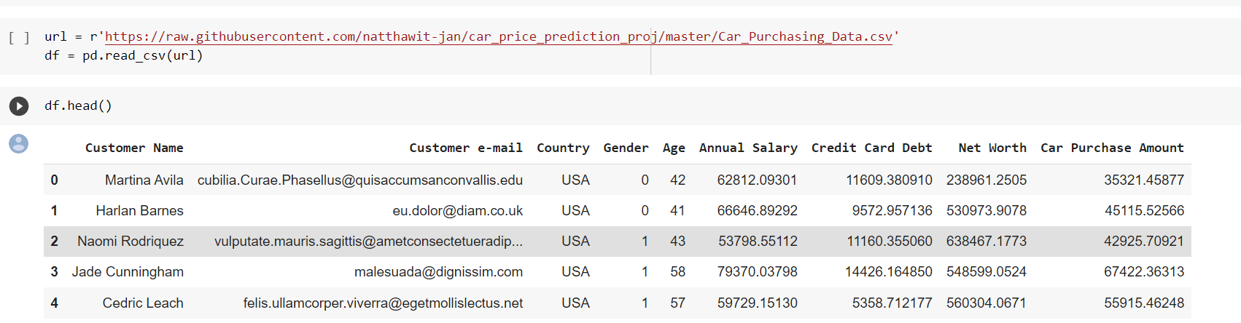
Import Data

Slide 5
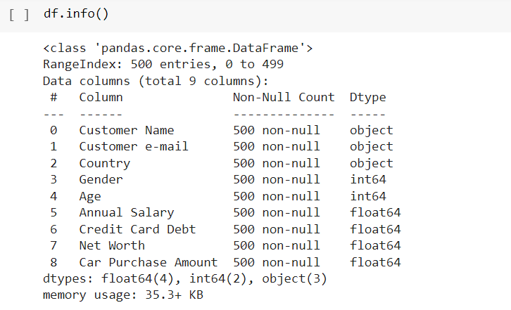
Check Data Missing

Slide 6
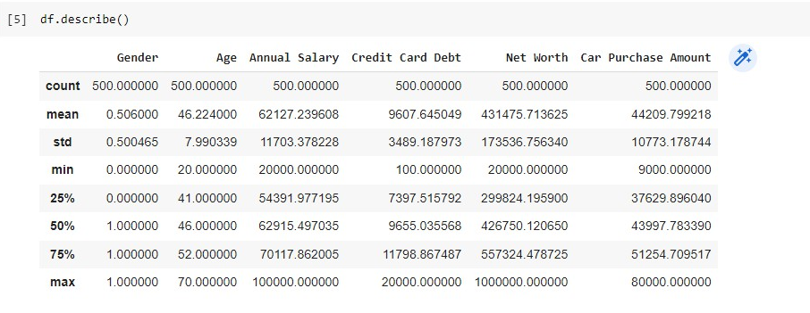
Exploratory Data Analysis
(EDA)

Slide 7
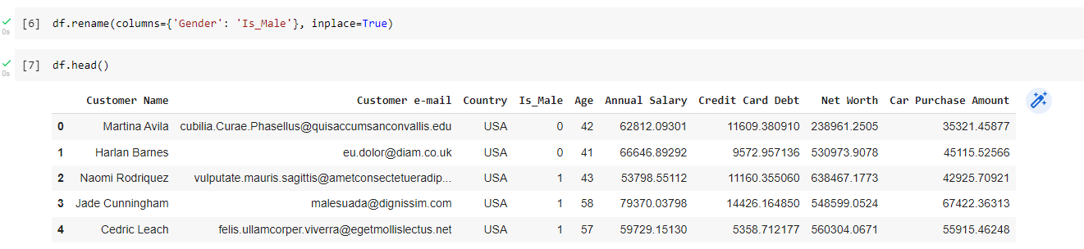
Data Preparation
Rename the column of gender to is_male, where 1 indicates male and female otherwise

Slide 8
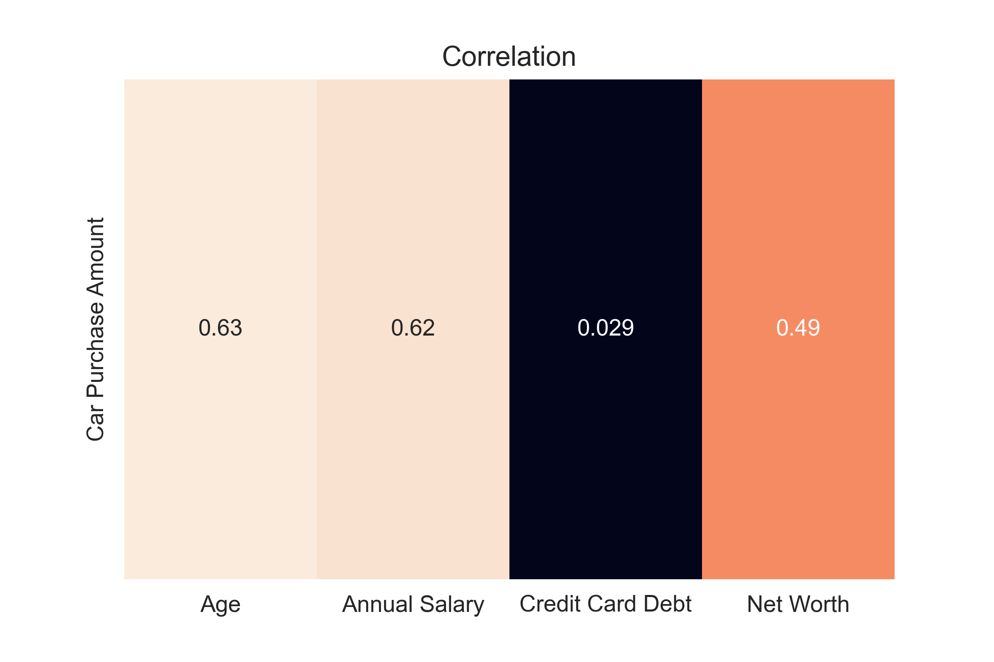
Correlation Heat map

Slide 9
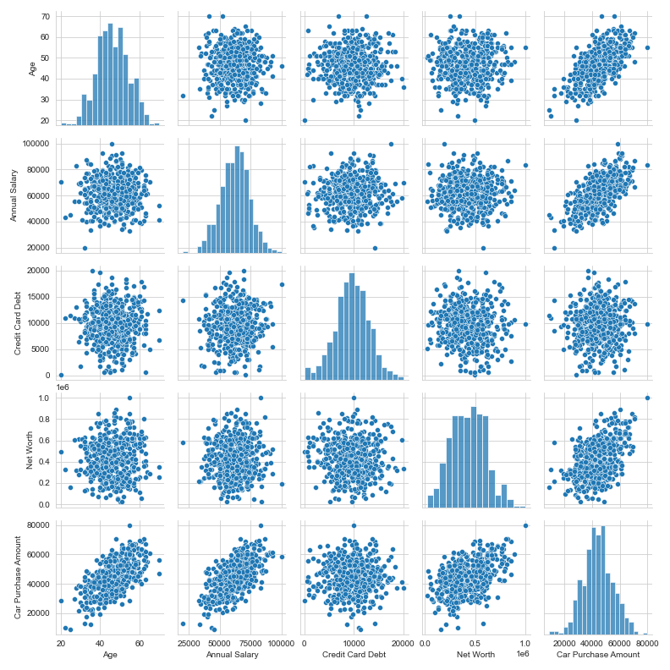
Finding Correlation
between X and Y

Slide 10
Zoom in 3 linear features

Slide 11
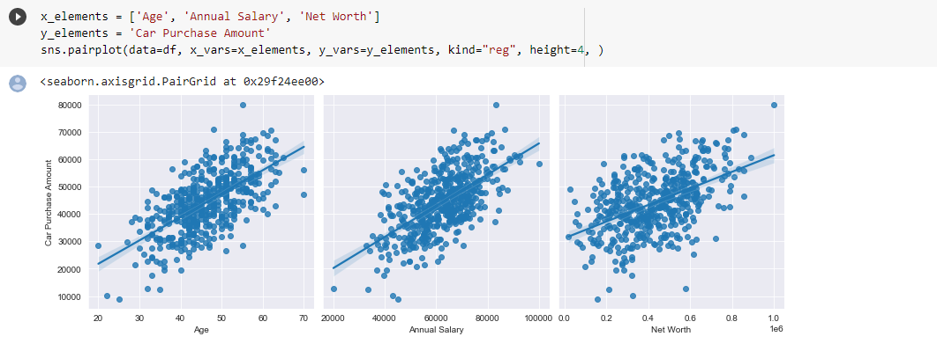
Regression plots for 3 linear features
Therefore, looking from the plots, we can see that there are mainly 3 features that look linear and can be used to train the model. Age, Net Worth and Annual Salary.

Slide 12
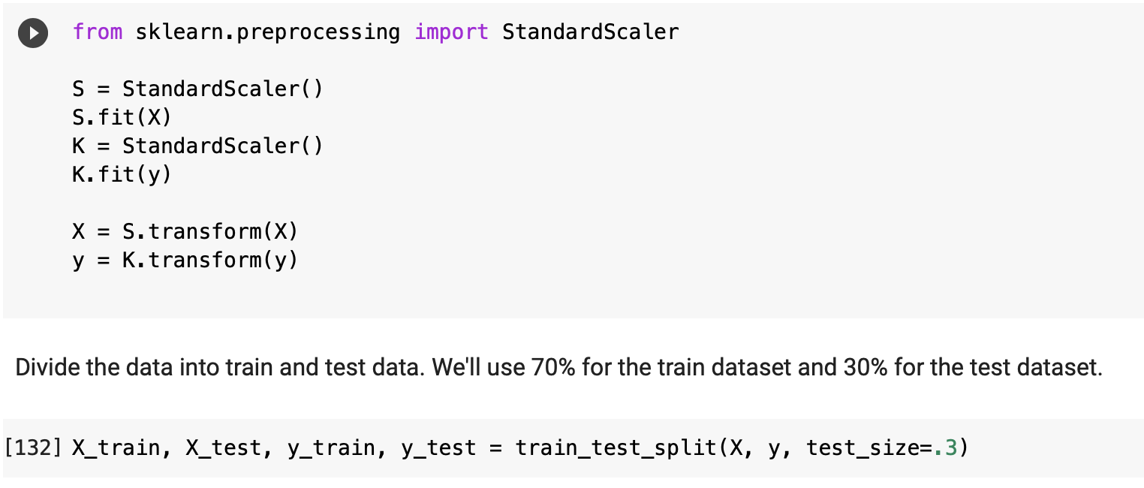
Standardize and Split Data

Slide 13

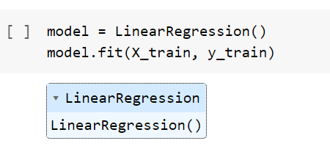
Import Linear Regression model + train data

Slide 14
Standardize and Split Data

Slide 15
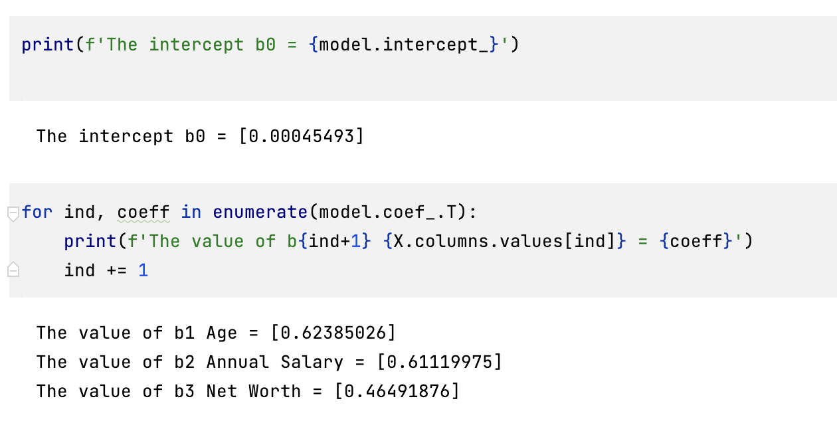
Get all coefficients from the trained model

Slide 16
The regression equation
If `Age` goes up by 1 unit, the car price will also go up by 0.62
If `Annual Salary` goes up by 1 unit, the car price will also go up by 0.61
If `Net worth` goes up by 1 unit, the car price will also go up by 0.46

Slide 17
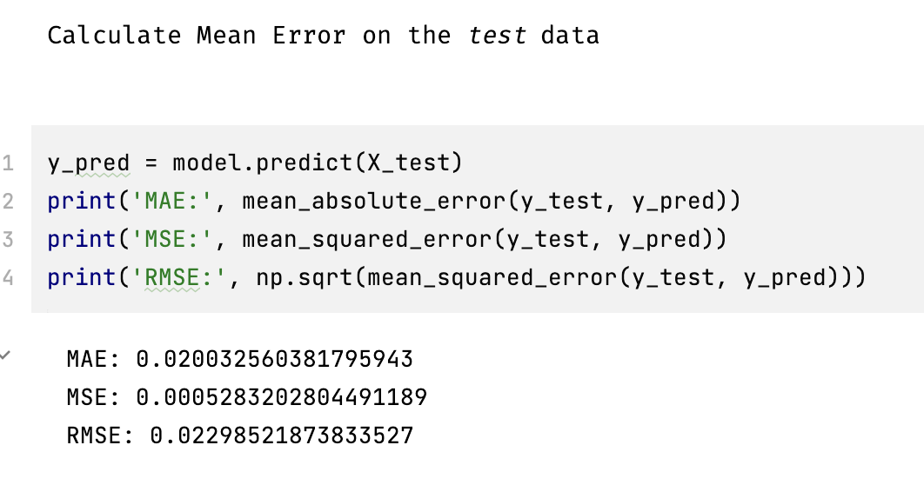
Predict the outcome with test data + Calculate error

Slide 18
From the RMSE result, our model in general can be wrong by 0.023 (std.) ( around $44,400 off )

Slide 19
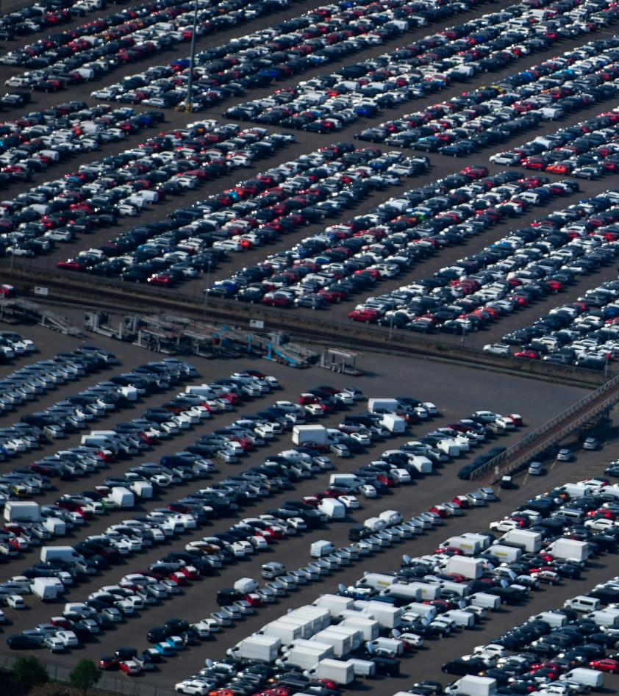
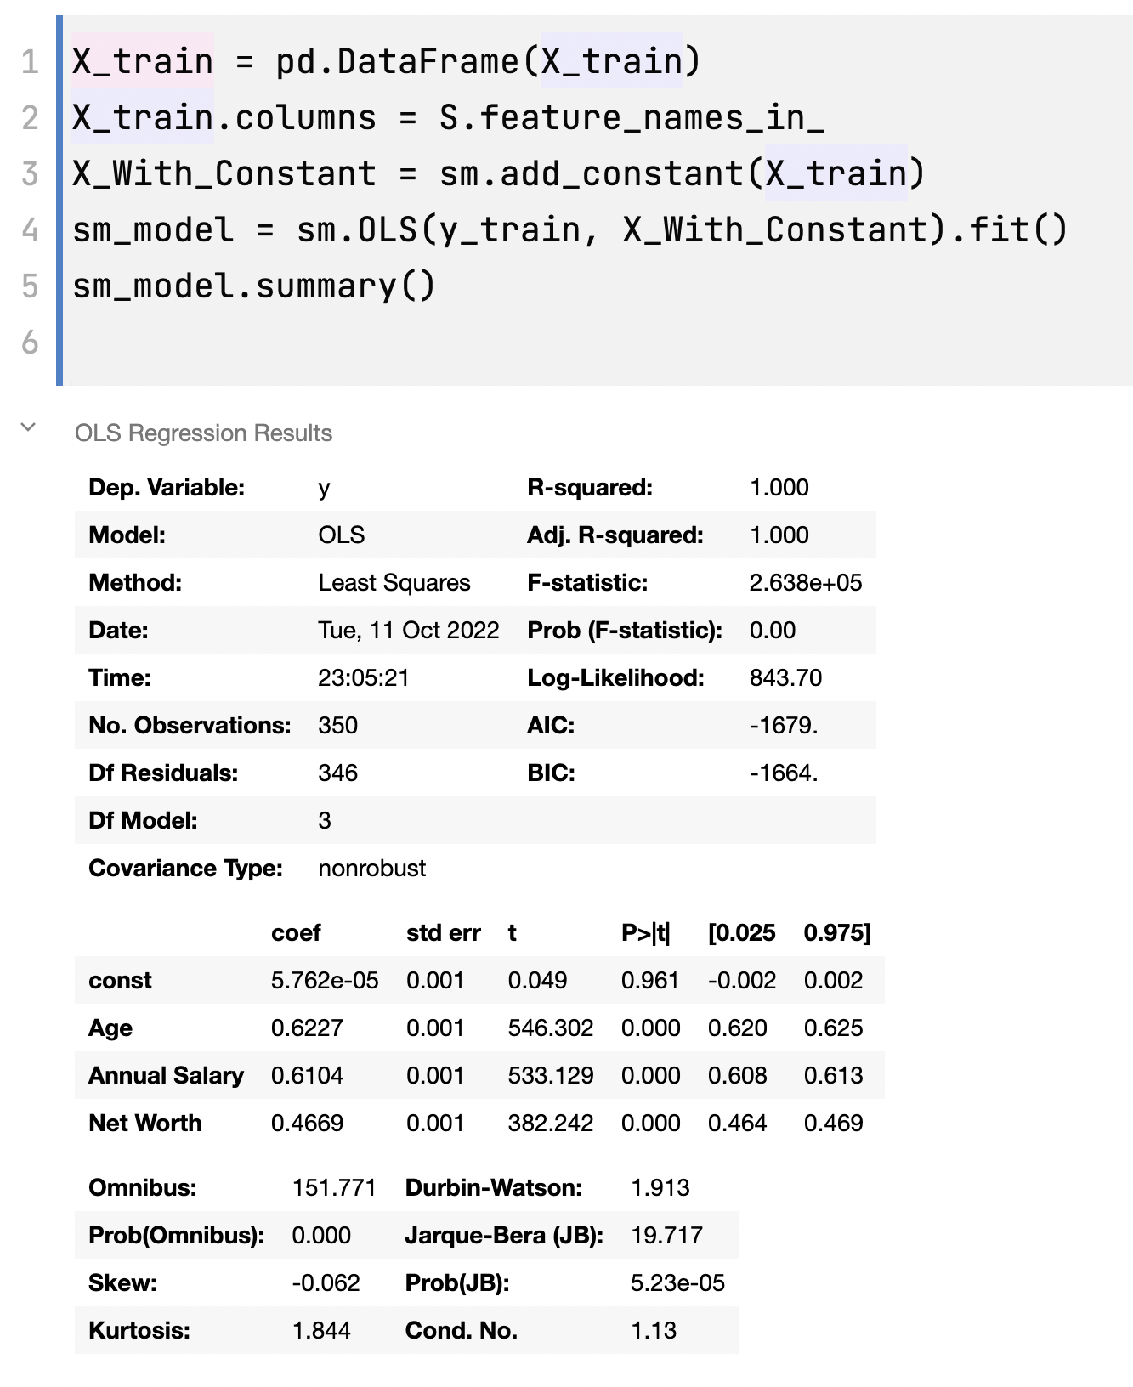
ANOVA TABLE
(Analysis of Variance)

